Slide 1

Find Your Dublin
Group 1 MSc Team Project

Slide 2
User Persona – International Student in Dublin
What this student needs
Persona statement
Convenient public transport
A manageable commute to university
Nearby supermarkets and grocery options
Everyday and lifestyle amenities
A safe and comfortable neighbourhood
“I want to live in a Dublin area where I can easily use public transport, access my everyday needs nearby, and feel safe and comfortable.”

Slide 3
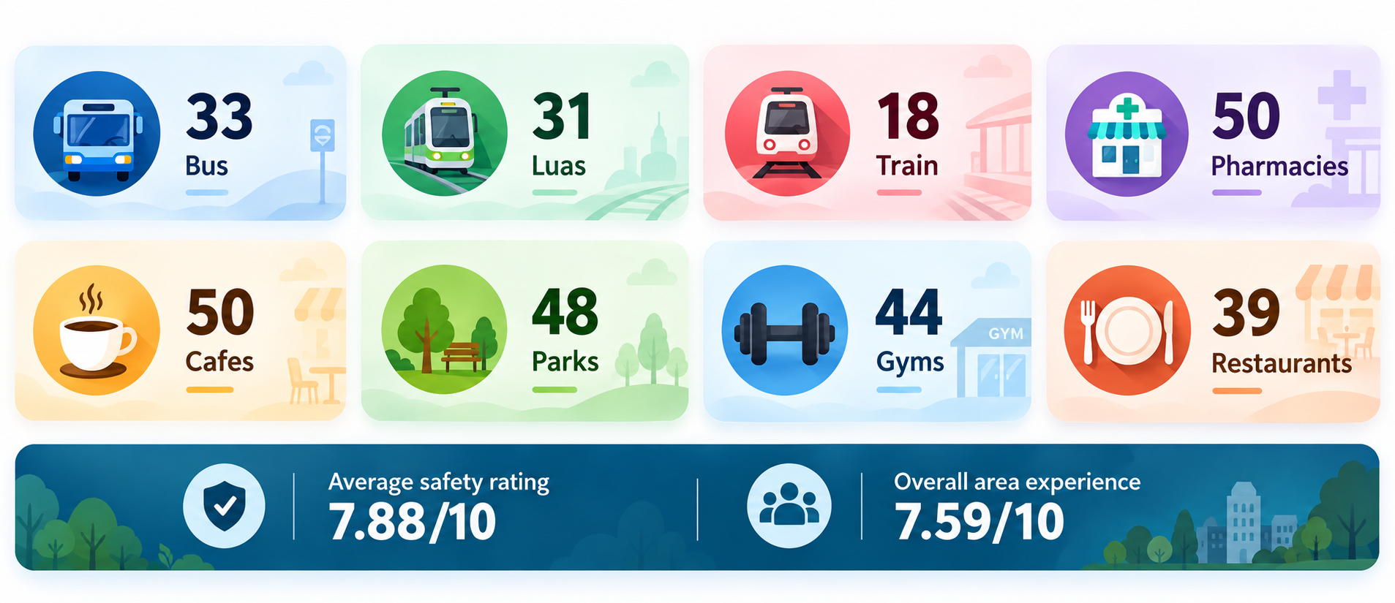
What Did Students Tell Us?
Key patterns identified from 59 survey responses

Slide 4
How the Persona Informs Our System
Survey findings
Identify common student needs
Recommendation factors
Rent • Commute • Groceries • Amenities
Student preferences
Students can give different importance to factors
Personalised ranking
Recommend the Dublin areas that best match
Different students can have different priorities, so the system should not recommend the same area to everyone.

Slide 5
Data Collected
RTB average rent (CSO table RIA02)
Daft.ie listings, D6–D10
Data all over Ireland, 2008–2025: 337,176 rows
Kept limited data for 2025 only
Removed the area code out of the location (e.g. "Rathmines, Dublin 6" → D6)
Result: 137 rows for D6–D10, saved in the same format as our other RTB files
142 listings collected
Converted weekly rent to monthly
Room types renamed to match D1–D3 (single, double, etc)
D6 | D7 | D8 | D9 | D10
40 | 38 | 29 | 24 | 11
Notes:
This week my job was getting rent data for Dublin 6 to Dublin 10, so the recommender could cover more areas than just D1 to D3.
I used two sources. The first is the RTB average rent table, which comes from the CSO. It covers all of Ireland from 2008 to 2025, so it's over 337,000 rows. I filtered it down to just 2025 and "all property types", and then pulled the area code out of the location name, so "Rathmines, Dublin 6" becomes D6. That left 137 rows for our five areas, and I saved it in the same format as the RTB files we already had, so the code could read it straight away.
The second source is Daft.ie. I collected 142 listings by hand: 40 in D6, 38 in D7, 29 in D8, 24 in D9 and 11 in D10. Some listings were priced per week, so I converted those to monthly by multiplying by 4.33. I also tidied up the room types so they match the labels in our D1 to D3 files.

Slide 6
RTB records compared to asking rents
€450–760
more per month asked on Daft than the RTB average, for a one-bed in D7–D9
Why: RTB counts rents people already pay on existing leases. Daft shows what a student would pay if they signed today.
Notes:
Once both datasets were clean, I compared them, and this was the most interesting result.
The light bars are the RTB average for a one-bed in 2025, and the dark bars are the median asking rent on Daft right now. In every area the Daft price is higher. In D7 it's about €450 a month more, and in D9 it's about €760 more.
The reason is that RTB records rents on leases that already exist, and many of those started years ago at lower prices. Daft shows what you'd actually pay if you started looking today, which is the situation our users are in.
So for our project this matters: if we only use RTB, the recommender will make areas look cheaper than they really are for a new student. D10 isn't on the chart because I didn't find any one-bed listings there.

Slide 7
Changes to code
What I changed
Before
After
3
→
8
Added the D6–D10 rent files to the room data list
Added the new RTB file to the RTB list
Added amenity counts and commute times for the new areas
areas: D1–D3
areas: D1-D3, D6–D10
Result: D7 now shows up in the recommendations, close to Grangegorman and one of the cheapest areas for rooms.
Live Code
Run it in collab
Notes:
Finally, I added all of this into our recommender code.
Before this week, the recommender could only compare three areas, D1 to D3. Now it compares eight. To do that I added the new rent files and the new RTB file to the lists the code loads, and added the amenity counts and commute times for the new areas. I also changed how the notebook loads the data. Downloading the shared folder with gdown kept failing on permissions, so now it reads the files directly from Google Drive, which is more reliable.
The result is that D7 now appears in the recommendations. It's close to Grangegorman, and rooms there are some of the cheapest in our data, so it makes sense for a student on a budget.
There are still a couple of gaps. I didn't find any single or double room listings in D9, so D9 drops out when someone searches for a room, and D10 only has 11 listings. Next week I'd like to collect more listings for those two areas.

Slide 8
Commute distance calculation
Data & Point Selection
  Dublin Postal District GeoJSON
  5 landmarks per district - North, South, Centre, East, West were selected manually.
  Selected landmark coordinates were validated against the postal boundaries to ensure they lie within the district.

Slide 9

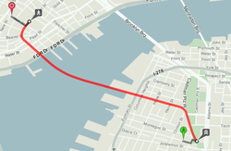

Open Trip Planner (OTP) routing process
OTP- Routing engine which combines OSM and TFI GTFS data together for route calculation
TFI GTFS- public transport routes, stops & schedules
OpenStreetMap- Walking distance
OTP calculates routes using walking + public transport + transfers

Slide 10
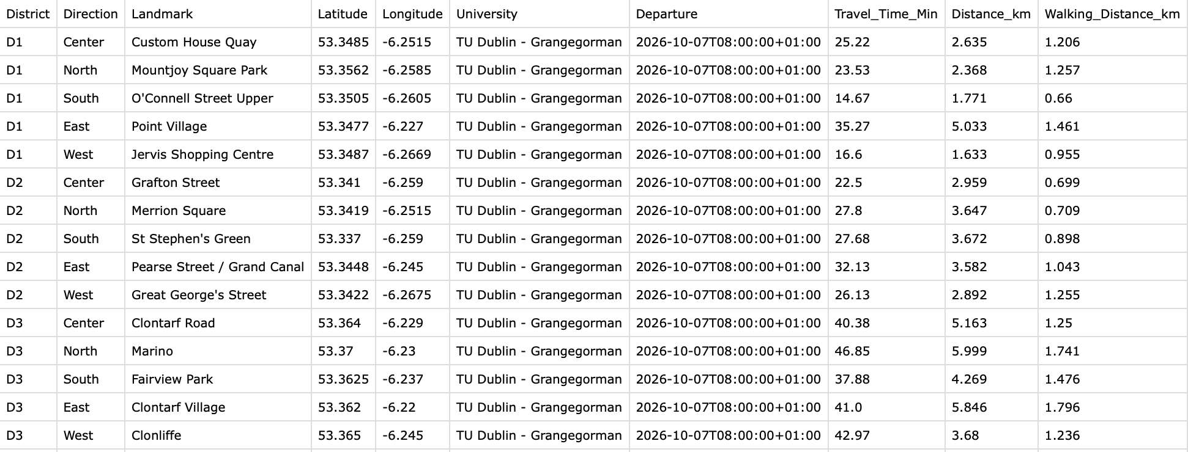
Commute Output
Python code automated 105 origin points to TU Dublin Grangegorman route queries
Selected the fastest valid public-transport journey
Results are later stored in a structured CSV dataset

Slide 11




UPDATE ON TECH STACK
Azure for Students – 100$ Free credit for 12 months.
One platform for hosting Frontend, Backend and Database.

Slide 12





Azure services we use:

Slide 13
F1 – Free
Shared machine, 60 CPU min/day
Sleeps when idle, 20–30 s first load
B1 – Basic
Dedicated: 1 CPU core, 1.75 GB RAM, 10 GB storage
Always On, no sleep delay
About $13/month on Linux, from student credit

Slide 14
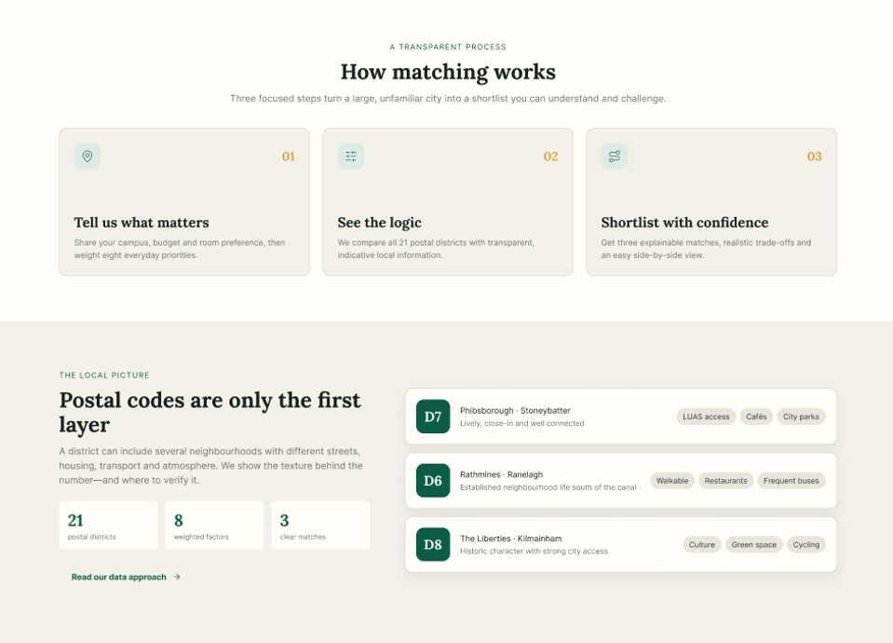
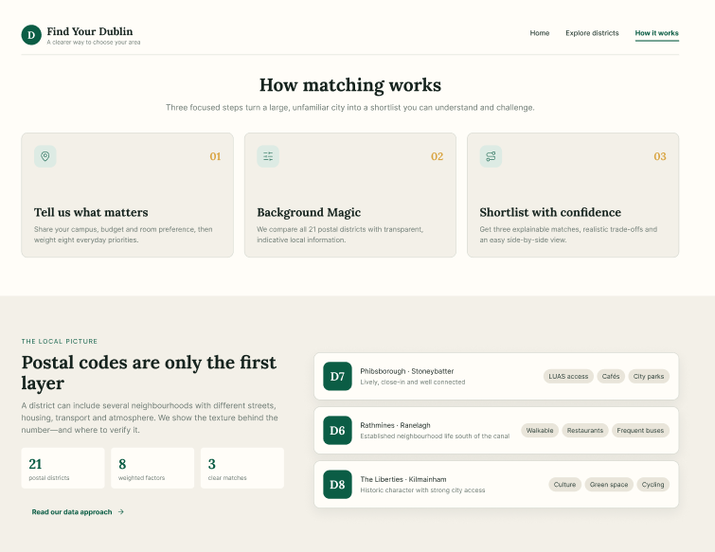
Figma Prototype — UI Improvements
BEFORE
AFTER

Slide 15
Requirement Specification
Requirements grouped by priority
A — Core requirements
B — Supporting requirements
C — Additional requirements
• Recommend top 3 areas
• Explain the recommendation
• Map view for district information
• Calculate commute distance
• Area demographics
• Make website more attractive
• Find supermarkets
• International community
• Find parks and gyms
• Student feedback
• Find cafés and restaurants
• Find pharmacies and hospitals
• Mobile responsive UI
A = essential B = supporting C = additional

Slide 16
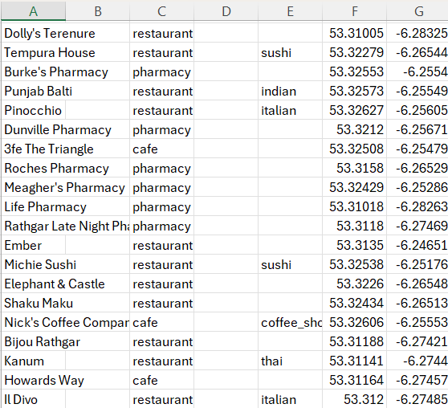
Data Collection & Next Steps
THIS WEEK
- Data collected for D6–D10
D6 — Amenities dataset
NEXT WEEK
D11 → D25
• Collect data
• Connect frontend + backend
• Build mobile UI
Collect → Connect → Build
Next step: integrate the data with the UI.

